Slide 1



Greedy Algorithms
Brute-Force, Heuristic Algorithms
Greedy Algorithms
SoftUni Team
Technical Trainers
Software University
http://softuni.bg

Slide 2
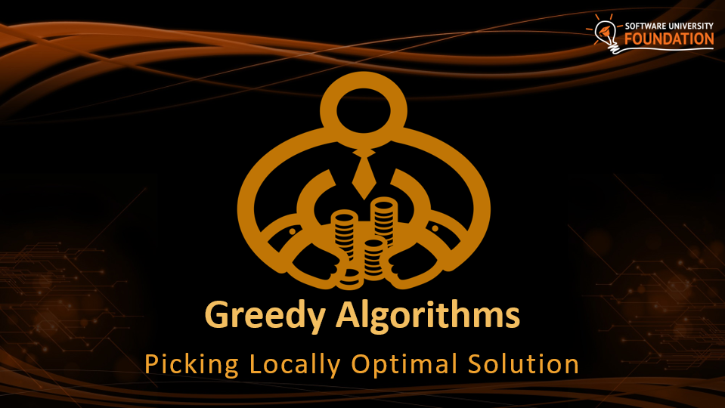
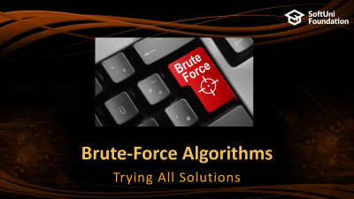
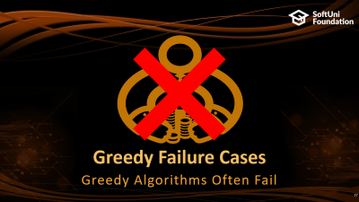
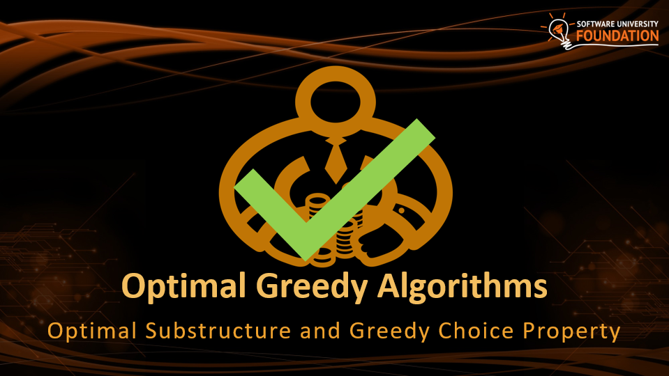
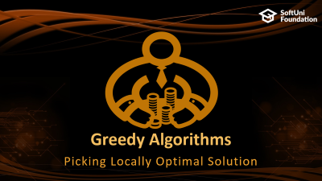
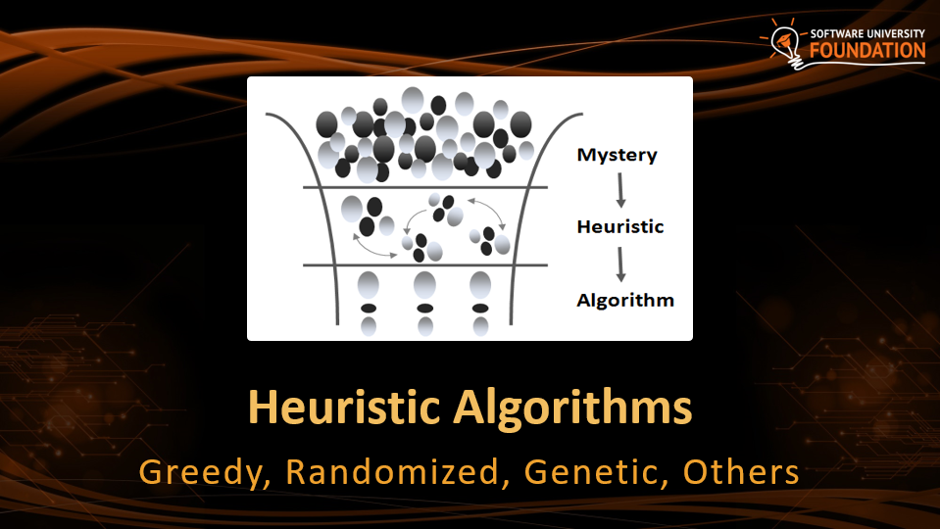
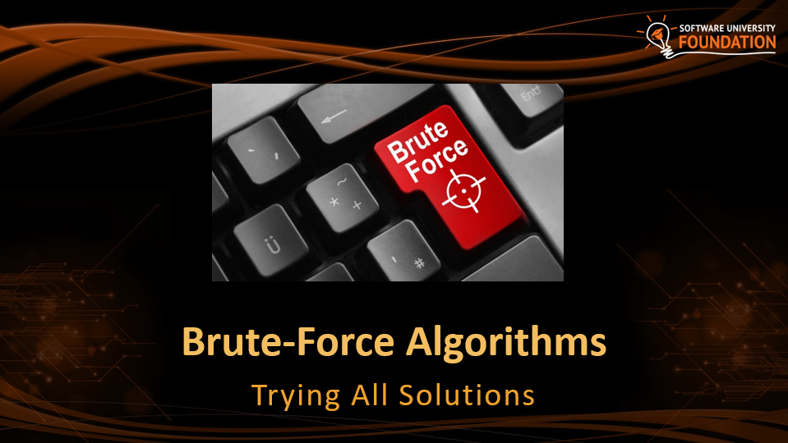
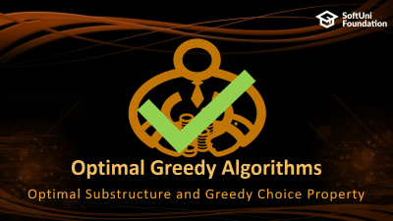
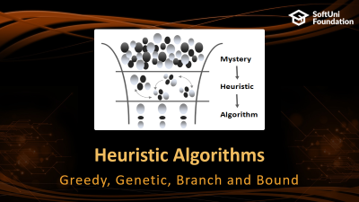
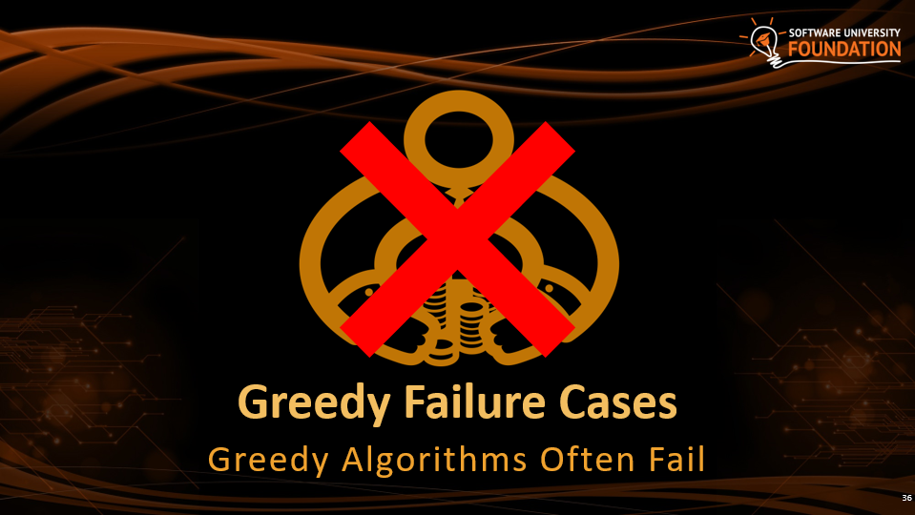
Table of Contents

Slide 3
Have a Question?
sli.do #DsAlgo

Slide 4

Brute-Force Algorithms
Trying All Solutions

Slide 5
Brute-Force Algorithms
Trying all possible combinations
Picking the best solution
Usually slow and inefficient
0
0
0
0
0

Slide 6
Brute-Force Algorithms
0
0
0
0
0

Slide 7
Brute-Force Algorithms
0
0
0
0
1

Slide 8
Brute-Force Algorithms
0
0
0
0
2

Slide 9
Brute-Force Algorithms
0
0
0
0
3

Slide 10
Brute-Force Algorithms
0
0
0
1
0

Slide 11
Brute-Force Algorithms
9
9
9
9
8

Slide 12
Brute-Force Algorithms
9
9
9
9
9

Slide 13
Brute-Force Algorithms
9
9
9
9
9
10 x 10 x 10 x 10 x 10 = 100,000 combinations

Slide 14

Greedy Algorithms
Picking Locally Optimal Solution

Slide 15
Optimization Problems
In computer science, an optimization problem is the problem of finding the best solution from all feasible solutions
Finding the optimal among many candidates
Examples of optimization problems:
Find the shortest path from Sofia to Varna on the map
Find the maximum increasing subsequence in integer sequence
Traveling salesman problem (minimal Hamilton cycle)
Find the shortest route that visits each city and returns to the origin city

Slide 16
Greedy Algorithms
Greedy algorithms are a category of algorithms
For solving optimization problems
Usually more efficient than the other algorithms
But can produce non-optimal (incorrect) result
Greedy algorithms pick the best local solution
Pick the optimum from their current position & point of view
Greedy algorithms assume always choosing a local optimum leads to the global optimum
This is sometimes correct, but sometimes it is not

Slide 17
Sum of Coins
1$
10¢
1¢
50¢
5¢
25¢
4¢
Problem

Slide 18
Greedy Algorithms: Sum of Coins
Consider the US currency coins:
{ 0.01, 0.02, 0.05, 0.10}
Problem "Sum of Coins":
Gather a sum of money, using the least possible number of coins
Greedy algorithm for "Sum of Coins":
Take the largest coin while possible
Then take the second largest
Etc.

Slide 19
Sum of Coins Visualization
Target: 18
10¢
5¢
2¢
1¢
10¢
5¢
2¢
1¢
Actual:
0

Slide 20
Sum of Coins Visualization
Target: 18
10¢
5¢
2¢
1¢
5¢
2¢
1¢
Actual:
10
10¢

Slide 21
Sum of Coins Visualization
Target: 18
10¢
5¢
2¢
1¢
2¢
1¢
Actual:
15
10¢
5¢

Slide 22
Sum of Coins Visualization
Target: 18
10¢
5¢
2¢
1¢
1¢
Actual:
17
10¢
5¢
2¢

Slide 23

Sum of Coins Visualization
Target: 18
10¢
5¢
2¢
1¢
Actual:
18
10¢
5¢
2¢
1¢

Slide 24
Sum of Coins – Solution
int finalSum = 18;
int currentSum = 0;
int[] coins = { 10, 10, 5, 5, 2, 2, 1, 1 };
Queue<int> resultCoins = new Queue<int>();
// Next Slide
Console.WriteLine("Sum not found");

Slide 25
Sum of Coins – Solution(2)
for (int i = 0; i < coins.Length; i++)
{
if (currentSum + coins[i] > finalSum) continue;
currentSum += coins[i];
resultCoins.Enqueue(coins[i]);
if (currentSum == finalSum)
// Sum Found
}

Slide 26
Peak Point
Problem

Slide 27
Greedy Algorithms: Peak Point
Find the peak point on a curve

Slide 28
Peak Point Visualization

Slide 29
Peak Point Visualization

Slide 30
Peak Point Visualization

Slide 31
Peak Point Visualization

Slide 32
Peak Point Visualization

Slide 33
Peak Point Visualization

Slide 34
Peak Point Visualization

Slide 35
Peak Point Visualization

Slide 36

Greedy Algorithm for Sum of Coins
Live Coding Exercise (Lab)

Slide 37

Greedy Failure Cases
Greedy Algorithms Often Fail

Slide 38
Sum of Coins Failure
Target: 18
10¢
5¢
4¢
1¢
10¢
5¢
4¢
1¢
10¢
5¢
4¢
1¢
Actual:
0

Slide 39
Sum of Coins Failure
Target: 18
10¢
5¢
4¢
1¢
10¢
5¢
4¢
1¢
5¢
4¢
1¢
Actual:
10
10¢

Slide 40
Sum of Coins Failure
Target: 18
10¢
5¢
4¢
1¢
10¢
5¢
4¢
1¢
4¢
1¢
Actual:
15
10¢
5¢

Slide 41
Sum of Coins Failure
Target: 18
10¢
5¢
4¢
1¢
10¢
5¢
4¢
1¢
4¢
Actual:
16
10¢
5¢
1¢

Slide 42
Sum of Coins Failure
Target: 18
10¢
5¢
4¢
1¢
10¢
5¢
4¢
4¢
Actual:
17
10¢
5¢
1¢
1¢

Slide 43
Sum of Coins Failure
Target: 18
10¢
5¢
4¢
10¢
5¢
4¢
4¢
Actual:
18
10¢
5¢
1¢
1¢
1¢

Slide 44
Sum of Coins Failure
Target: 18
10¢
5¢
1¢
1¢
1¢
10¢
4¢
4¢

Slide 45
Peak Point Failure

Slide 46
Peak Point Failure

Slide 47
Peak Point Failure

Slide 48
Peak Point Failure

Slide 49
Max Sum Path in Binary Tree
Largest sum path in a tree (starting at root)
Greedy strategy: choose largest next node
7
19
14
3
12
23
5

Slide 50
Max Sum in Binary Tree
Sum:
7
7
19
14
3
12
23
5

Slide 51
Max Sum in Binary Tree
Sum:
26
7
19
14
3
12
23
5

Slide 52
Max Sum in Binary Tree
Sum:
38
Sum:
0
Greedy
Actual
7
7
19
14
19
14
3
12
23
5
3
12
23
5

Slide 53
Max Sum in Binary Tree
Sum:
38
Sum:
7
Greedy
Actual
7
7
19
14
19
14
3
12
23
5
3
12
23
5

Slide 54
Max Sum in Binary Tree
Sum:
38
Sum:
21
Greedy
Actual
7
7
19
14
19
14
3
12
23
5
3
12
23
5

Slide 55
Max Sum in Binary Tree
Sum:
38
Sum:
44
Greedy
Actual
7
7
19
14
19
14
3
12
23
5
3
12
23
5

Slide 56
Optimal Greedy Algorithms
Optimal Substructure and Greedy Choice Property

Slide 57
Optimal Greedy Algorithms
Suitable problems for greedy algorithms have these properties:
Greedy choice property
Optimal substructure
Any problem having the above properties is guaranteed to have an optimal greedy solution

Slide 58
Greedy Choice Property
Greedy choice property
A global optimal solution can be obtained by greedily selecting a locally optimal choice
Sub-problems that arise are solved by consequent greedy choices
Enforced by optimal substructure

Slide 59
Optimal Substructure Property
Optimal substructure property
After each greedy choice the problem remains an optimization problem of the same form as the original problem
An optimal global solution contains the optimal solutions of all its sub-problems

Slide 60

Greedy Algorithms: Example
The "Max Coins" game
You are given a set of coins
You play against another player, alternating turns
Per each turn, you can take up to three coins
Your goal is to have as many coins as possible at the end

Slide 61
Max Coins – Greedy Algorithm
A simple greedy strategy exists for the "Max Coins" game
Always choose the local maximum (at each step)
You don't consider what the other player does
You don't consider your actions' consequences
The greedy algorithm works optimally here
It takes as many coins as possible
At each turn take the maximum number of coins

Slide 62
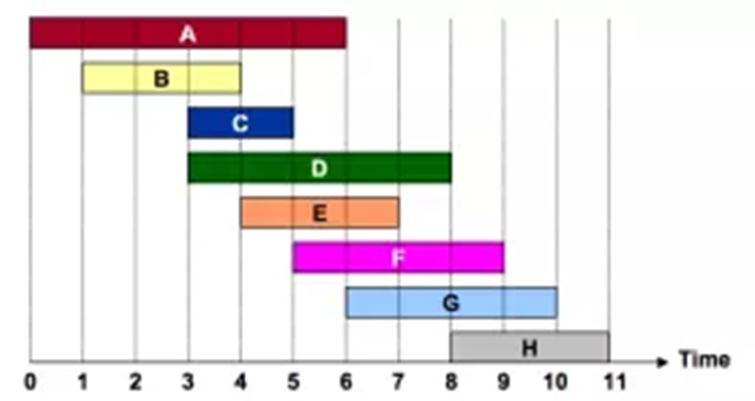
Activity Selection Problem
The Greedy Algorithm and Why It Is Optimal

Slide 63
Activity Selection Problem
The Activity Selection Problem (a.k.a. Conference Scheduling Problem)
Given a set of activities S = {a₁, a₂, …, a_{n}}
Each having a start & finish time: a_{i} = {s_{i}, f_{i}}
Activities are "compatible" if they don't overlap
i.e. their intervals do not intersect
What is the maximum-size subset of compatible activities?
i.e. which is the largest list of compatible activities that can be scheduled?

Slide 64
Activity Selection Problem – Example
Activity selection problem example:
Several optimal solutions: {a₁, a₄, a₈, a₁₁}, {a₂, a₄, a₉, a₁₁}, …
Index | 1 | 2 | 3 | 4 | 5 | 6 | 7 | 8 | 9 | 10 | 11
Start (s_{i}) | 1 | 3 | 0 | 5 | 3 | 5 | 6 | 8 | 8 | 2 | 12
Finish (f_{i}) | 4 | 5 | 6 | 7 | 8 | 9 | 10 | 11 | 12 | 13 | 14
0
1
2
3
4
5
6
7
8
9
10
11
12
13
14
15

Slide 65
Activity Selection Problem: Greedy
A greedy algorithm for the Activity Selection Problem:
Greedy characteristics of the above algorithm
Taking the earliest finish activity gives more time for all others
We pick an activity preserving the "maximum remaining time"
While (S in not empty)
Select from S an activity A with the earliest finish
Remove A + all activities from S conflicting with A

Slide 66
Activity Selection Problem: Implementation
Single scan (linear) implementation of the greedy algorithm for the Activity Selection Problem:
Sort the activities from S by their finish time
last = first activity from S
for (a in S)
if (a.Start >= last.Finish)
// a does not conflict with last
print a
last = a

Slide 67
Proving Greedy Optimality
To prove the discussed greedy is optimal we:
Need to prove the problem has a greedy choice property
Need to prove the problem has optimal substructure
Greedy properties are satisfied:
A solution starting with a greedy choice exists: the earliest finish
Optimal substructure exists:
If we remove the activity A with the earliest finish time activity
We reduce the problem to the same problem of smaller size (without activities in S, which intersect the activity A)

Slide 68
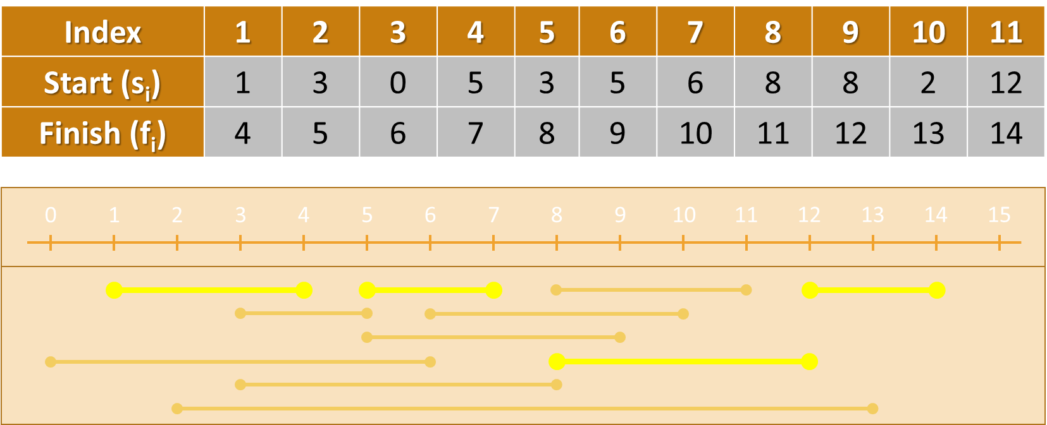
Activity Selection Problem
Live Demo

Slide 69
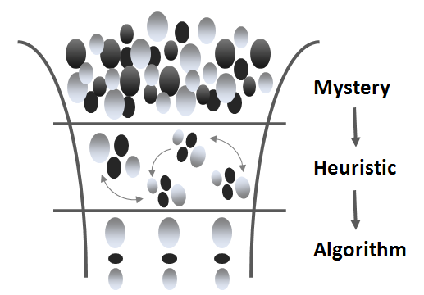
Heuristic Algorithms
Greedy, Genetic, Branch and Bound

Slide 70
Heuristic Algorithms
Some problems are hard to be solved (no fast algorithm exists)
Heuristic algorithms solve hard problems approximately
They find a good solution, but cannot guarantee it is optimal
Examples of heuristic algorithms:
Greedy algorithms – make a greedy choice at each step
Genetic algorithms – based on inheritance, mutation, selection, …
Branch and bounds – optimized backtracking with cut-offs
Others…

Slide 71
P vs NP
P - Category in which the algorithms are solvable in polynomial time
Polynomial -> 5N⁵ + 3N⁴ + N is O(N⁵)
Not a polynomial -> 2^{N}
P

Slide 72
P vs NP
NP - Category in which the algorithms are verifiable in polynomial time.
Decision problems
Example:
Does a route shorter than L exist?
Yes/No
NP
P

Slide 73
P vs NP
Knapsack
(Can a value >= V be achieved?)
Subset sum
NP-complete
Set-Cover problem
The hardest in NP
NP
Finding shortest route
Sorting
P
Look-ups in hash tables
Traversing lists

Slide 74

P vs NP
At least as hard as NP-complete
NP-hard
Knapsack (optimization)
(maximize V)
NP-complete
Halting problem
NP
Traveling salesman
P

Slide 75
P vs NP
NP-hard
NP-hard
NP-complete
NP-complete
NP
NP
P
P

Slide 76
P vs NP
NP-hard
NP-hard
NP-complete
NP-complete
NP
NP
P
P

Slide 77
P vs NP
NP-hard
NP-hard
NP-complete
NP-complete
NP
NP
P
P

Slide 78
P vs NP
Millennium Problem
Prize of $1,000,000
Prove either P=NP or P!=NP
Currently > 100 attempts
NP-hard
NP-complete
NP
P

Slide 79
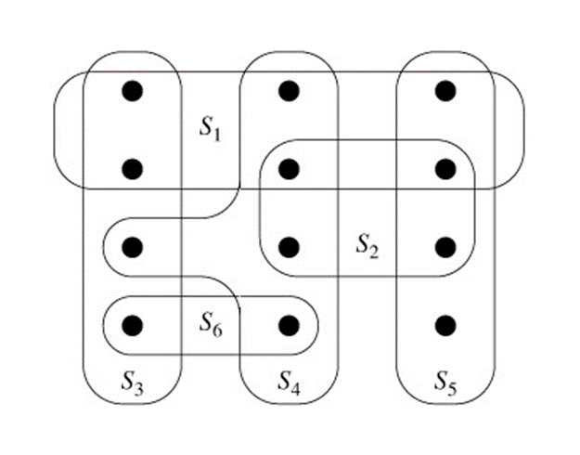
The Set Cover Problem
Using Greedy for Approximation

Slide 80
Set Cover Problem
The Set Cover Problem (SCP) is such a problem
SCP formulation:
Given a set U={1,2,…,m} called "the Universe"
And a set S={{…}, {…}, {…}, …} of n sets whose union = U
Find the smallest subset of S, the union of which = U (if it exists)
Example of SCP:
U = {1, 2, 3, 4, 5, 6}
S = { {1, 3}, {1}, {2, 4}, {2, 5}, {2, 6}, {2, 3, 6}, {4, 6}, {4, 5, 6}, {6} }

Slide 81
Set Cover Problem
The SCP turns out very complex!
The optimal solution is NP-complete
Infeasible for real-world calculations (unless P = NP)
Good solutions can be achieved through a greedy approach:
At each step pick the set containing the largest number of uncovered elements, e. g.
U = {1, 2, 3, 4, 5, 6}
S = { {1, 3}, {1}, {2, 4}, {2, 5}, {2, 6}, {2, 3, 6}, {4, 6}, {4, 5, 6}, {6} }

Slide 82
The Set Cover Problem
Live Coding Exercise (Lab)

Slide 83
References & Further Reading
Recommended further reading on greedy algorithms:
Lecture @ Boston University (Shang-Hua Teng)
www.cs.bu.edu/~steng/teaching/Fall2003/lectures/lecture7.ppt
Lecture @ University of Pennsylvania
www.cis.upenn.edu/~matuszek/cit594-2005/Lectures/36-greedy.ppt
Book on Algorithms @ Berkeley University
www.cs.berkeley.edu/~vazirani/algorithms/chap5.pdf
Book "Programming = ++ Algorithms;" – Chapter 9
www.programirane.org

Slide 84

Summary
Greedy algorithms make local optimal decision at each step and expect to achieve the global optimal solution
Greedy algorithms give optimal solution for problems holding:
Greedy choice & optimal substructure
Heuristic algorithms give approximation
Not always the optimal solution

Slide 85







Greedy Algorithms
https://softuni.bg/opencourses/algorithms

Slide 86
License
This course (slides, examples, labs, videos, homework, etc.) is licensed under the "Creative Commons Attribution-NonCommercial-ShareAlike 4.0 International" license
Attribution: this work may contain portions from
"Fundamentals of Computer Programming with C#" book by Svetlin Nakov & Co. under CC-BY-SA license
"Data Structures and Algorithms" course by Telerik Academy under CC-BY-NC-SA license

Slide 87





Trainings @ Software University (SoftUni)
Software University – High-Quality Education, Profession and Job for Software Developers
softuni.bg
Software University Foundation
http://softuni.foundation/
Software University @ Facebook
facebook.com/SoftwareUniversity
Software University Forums
forum.softuni.bg

